Slide 1
Collaboration Network of Spotify Artists
Ayan Chatterjee
Ph.D. Student
Network Science Institute

Slide 2
Network
Spotify Artist Collaboration Network (Undirected, Unipartite)
Nodes: Artists
Links: Songs
Data
Spotify Web API curated data of artists and songs released between 1921-2020
Includes information about more than 160,000 songs
Information about the songs like acousticness, duration, tempo and loudness

Slide 3
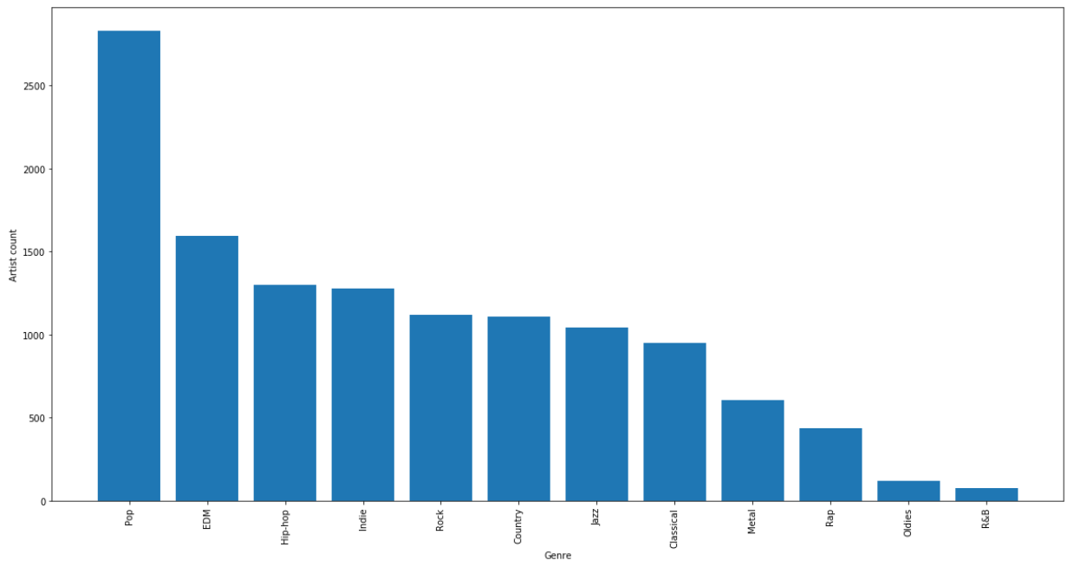
Song Attributes
Genre of music: Obtained using Spotify API
All songs divided into 12 major genres

Slide 4
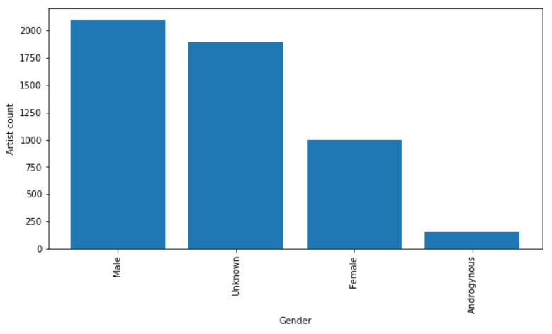
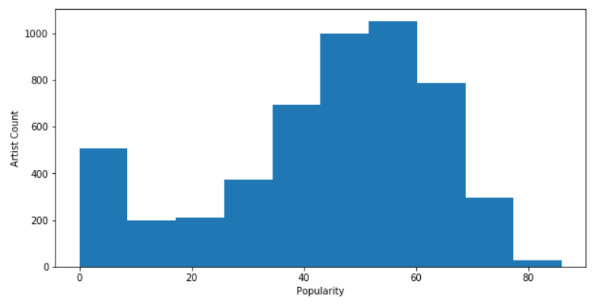
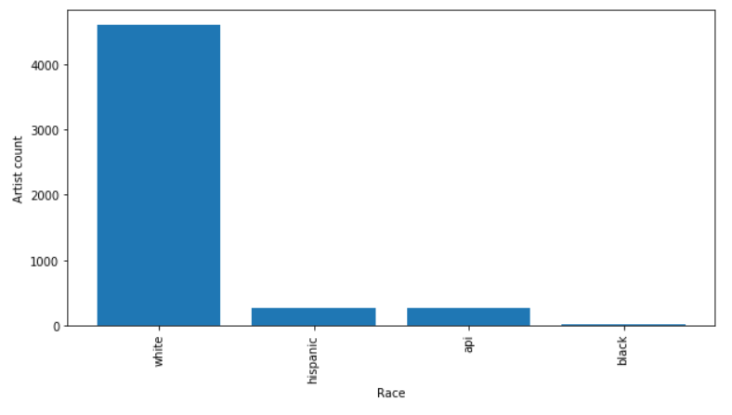
Artist Attributes
Gender: Derived using NLP technique
Race: Derived using NLP technique
Popularity: Normalized total streams
Notes:
Gender: https://github.com/lead-ratings/gender-guesser
Race: https://github.com/appeler/ethnicolr (0.9 AUC and 83% accuracy)

Slide 5
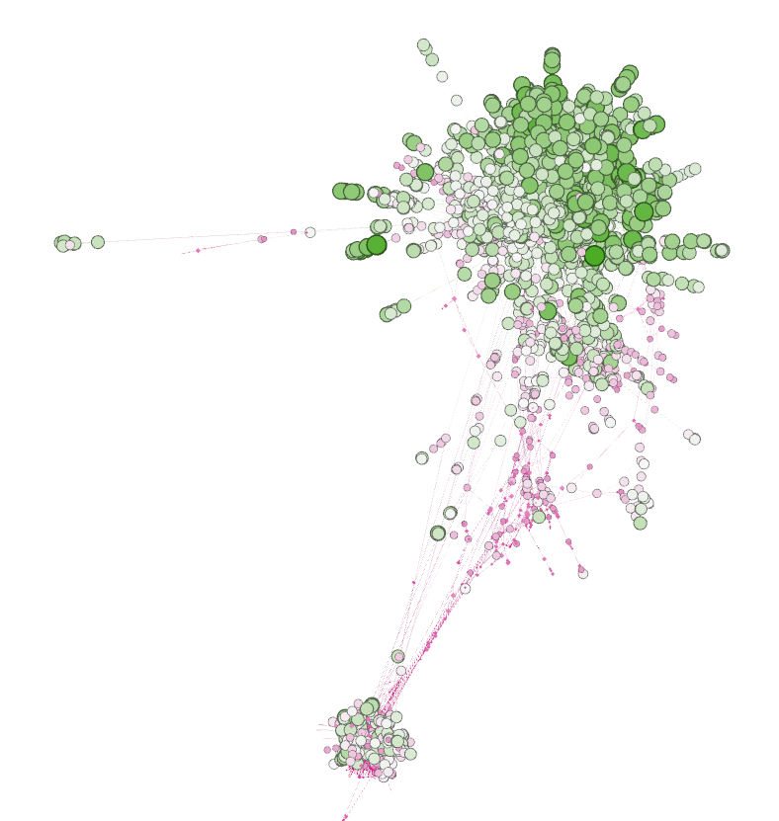
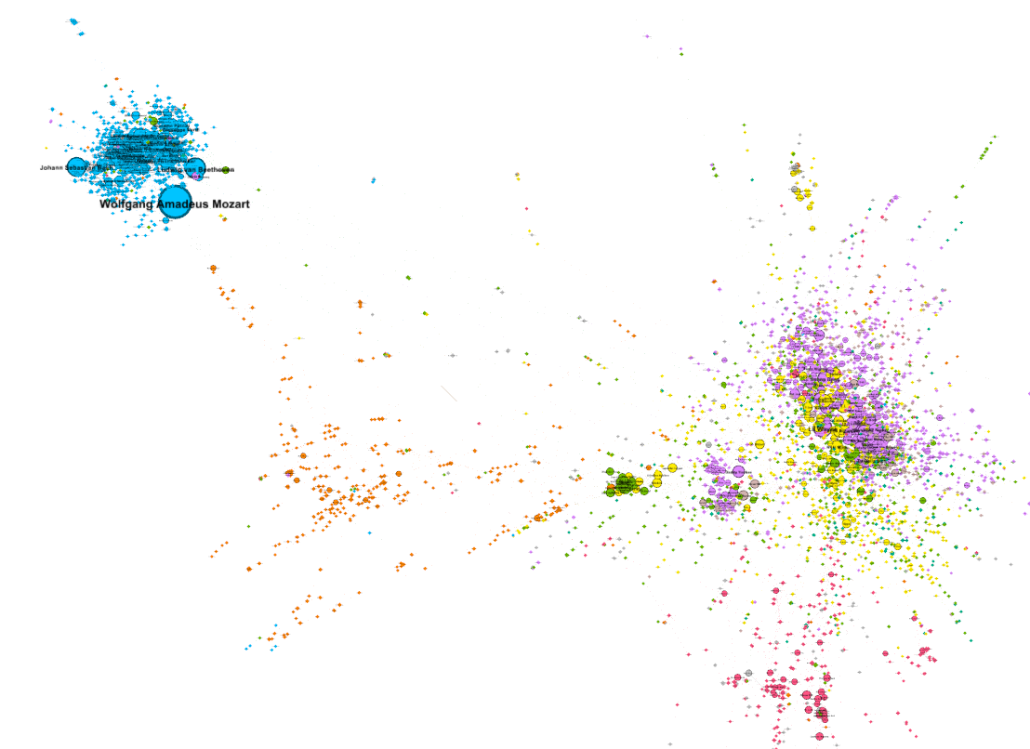

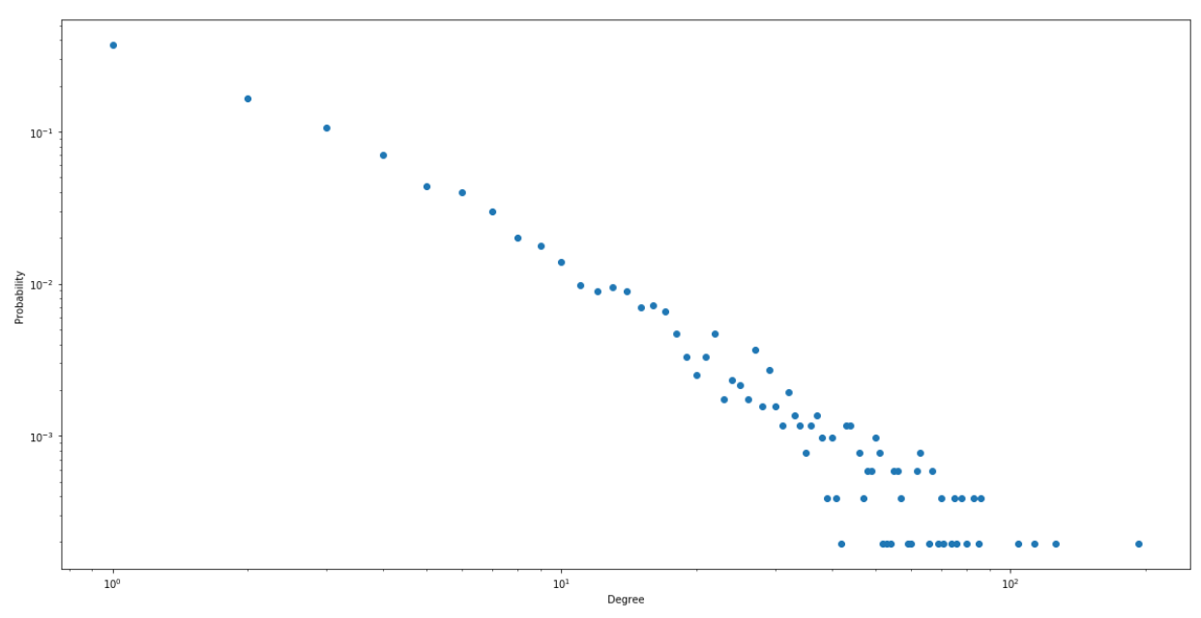
Network Visualizations
Nodes: 5,142 and Edges: 12,905
Popularity
0
100
Genre
Notes:
Gender guesses: https://pypi.org/project/gender-guesser/

Slide 6
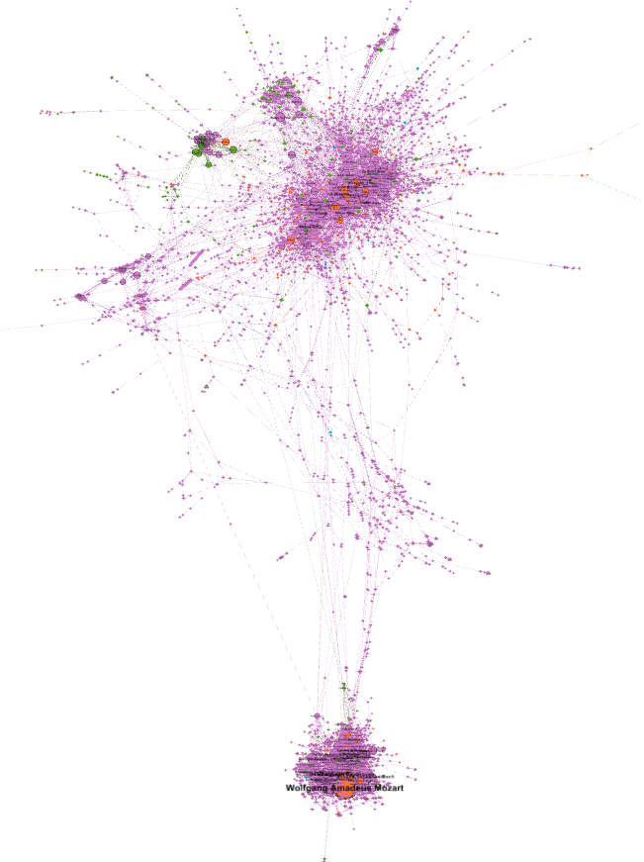
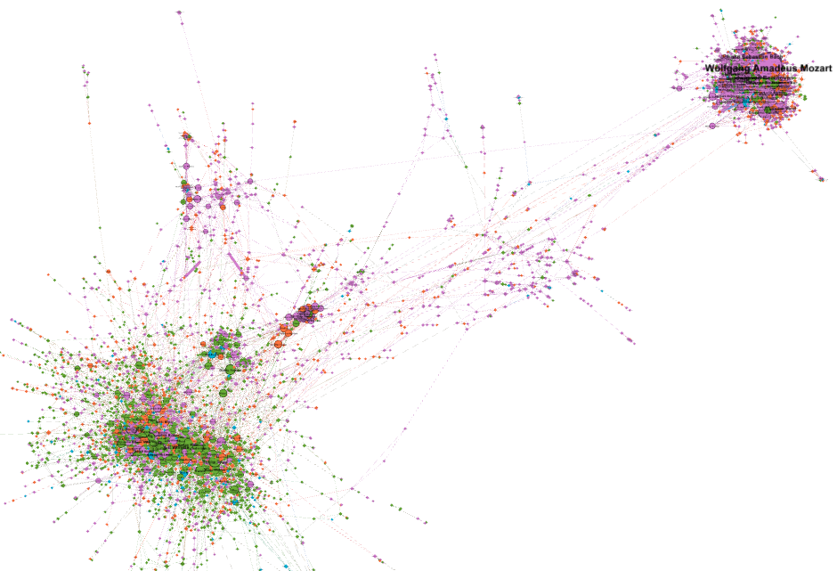


Network Visualizations
Gender
Race
Notes:
Gender guesses: https://pypi.org/project/gender-guesser/

Slide 7
Inter Group Collaboration
Collaboration Fraction = Existing links between groups / Possible link between the groups
Possible link between the groups = m*n = 12
Existing links between groups = 4
Collaboration Fraction = 4/12 = 0.33
m = 4
n = 3

Slide 8
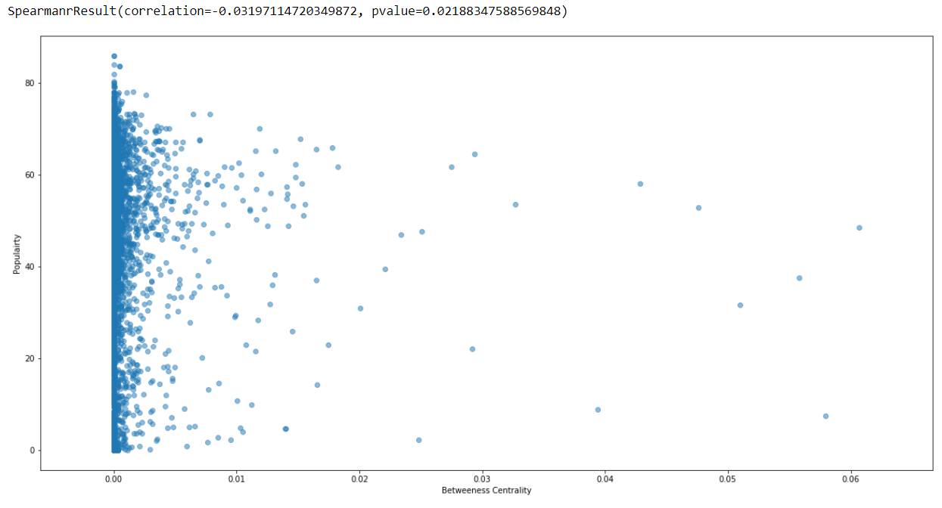
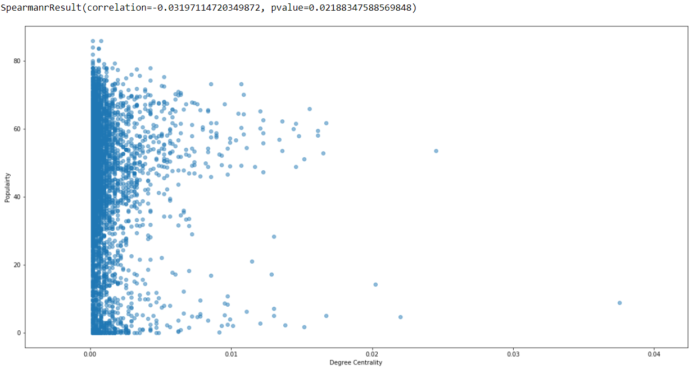
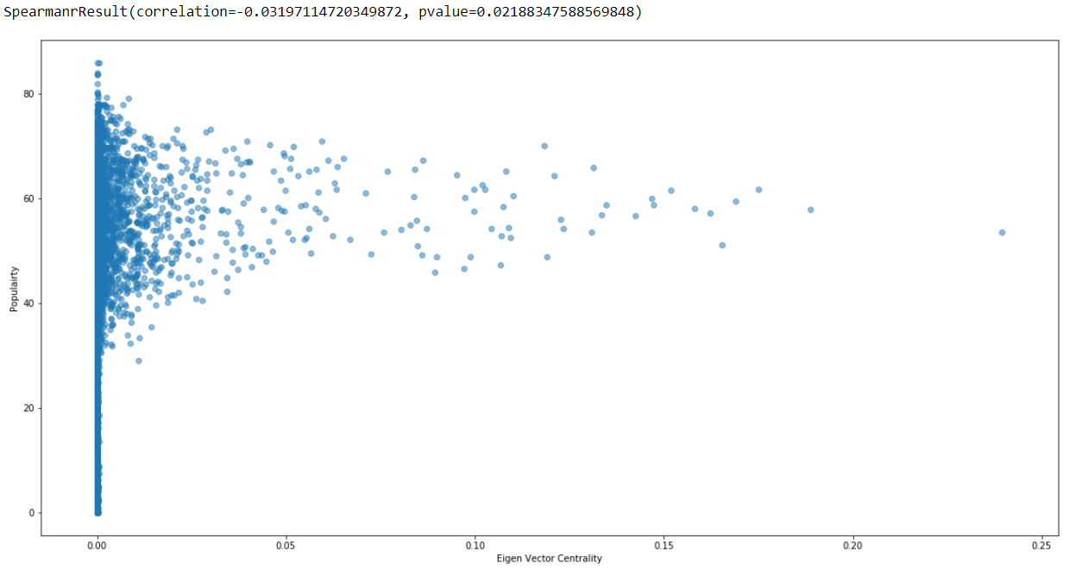
Degree VS Popularity
Degree, betweenness and Eigen vector centralities are not correlated with the popularity of an artist

Slide 9
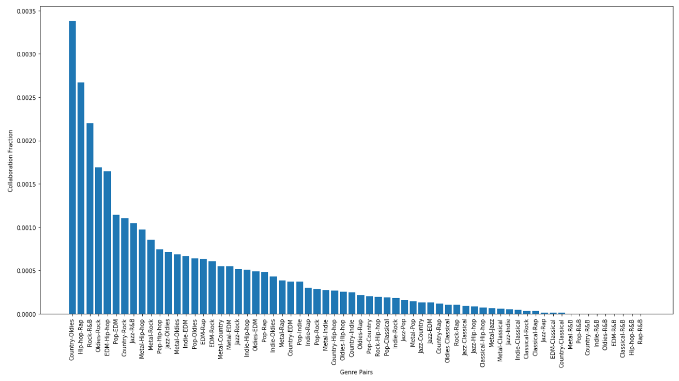
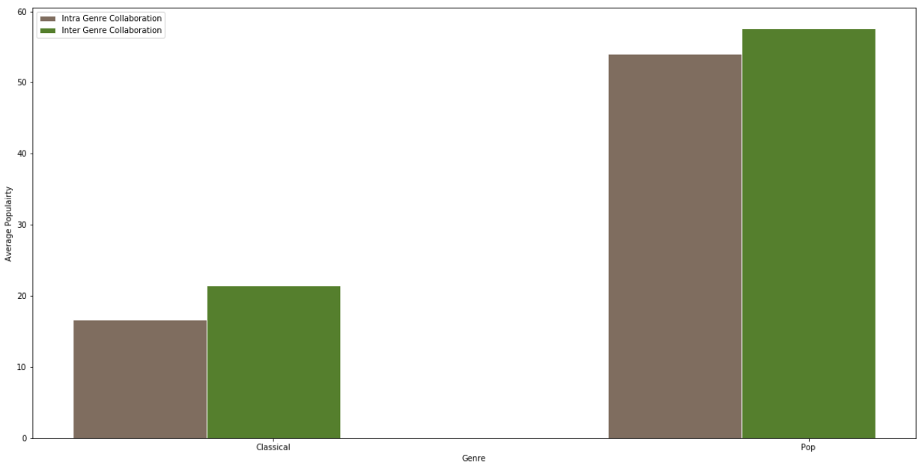
Hypothesis 1
Scientific Collaboration:
In academia, productive authors tend to directly coauthor with and closely cite colleagues sharing the same research interests; they do not generally collaborate directly with colleagues having different research topics, but instead directly or indirectly cite them [1].
Musical Collaboration:
Musicians from different genres tend to collaborate more with each other. Inter-genre collaborations tend to be more successful compared to intra-genre music.
Communities that don’t collaborate
Less collaboration of classical musicians with other genres
Notes:
[1] Ding Y. Scientific collaboration and endorsement: Network analysis of coauthorship and citation networks. J Informetr. 2011;5(1):187-203. doi:10.1016/j.joi.2010.10.008

Slide 10
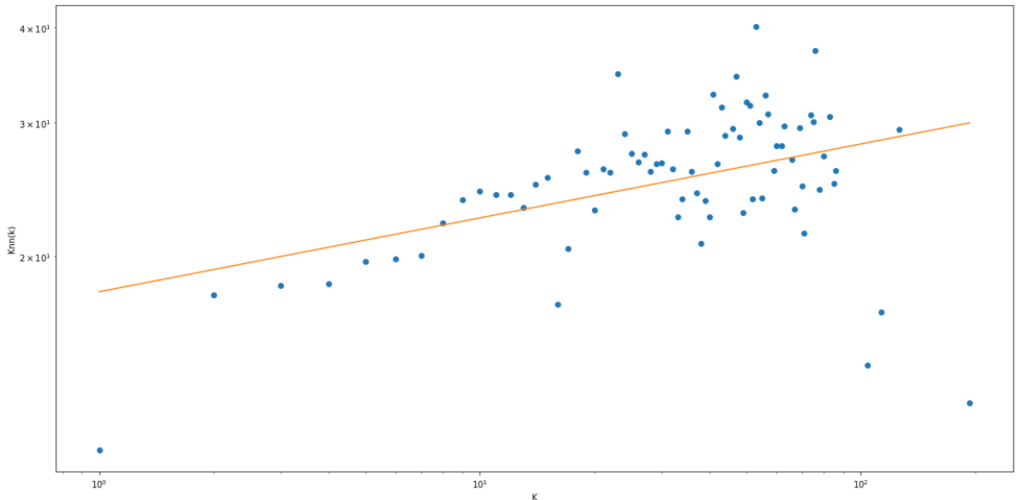
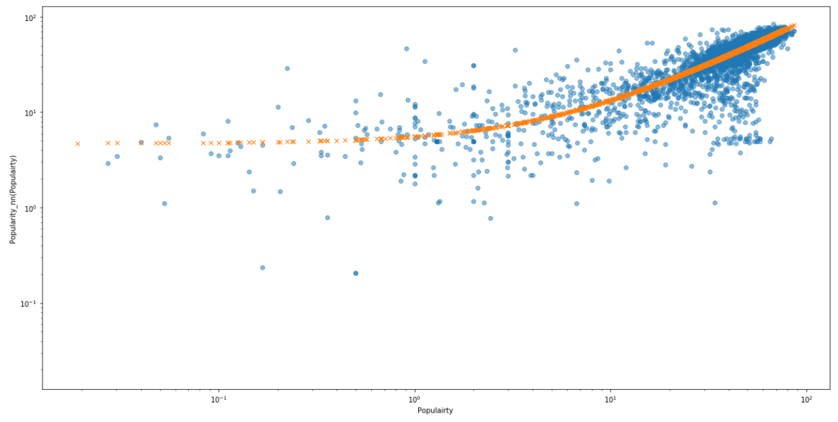
Hypothesis 2
Scientific Collaboration:
Highly cited authors do not generally coauthor with each other, but closely cite each other [1].
Musical Collaboration:
In music, popular artists seem to collaborate among themselves more than collaborating with less popular or budding artists.
Degree correlation exponent: 0.09
Stronger than linear correlation in log-log space
Popularity assortativity is stronger than degree assortativity
Artists always want to collaborate with the popular ones.
Notes:
[1] Ding Y. Scientific collaboration and endorsement: Network analysis of coauthorship and citation networks. J Informetr. 2011;5(1):187-203. doi:10.1016/j.joi.2010.10.008

Slide 11
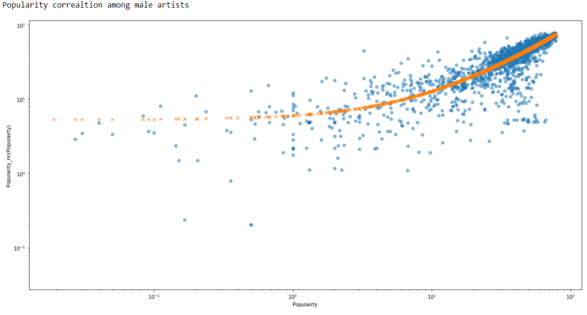
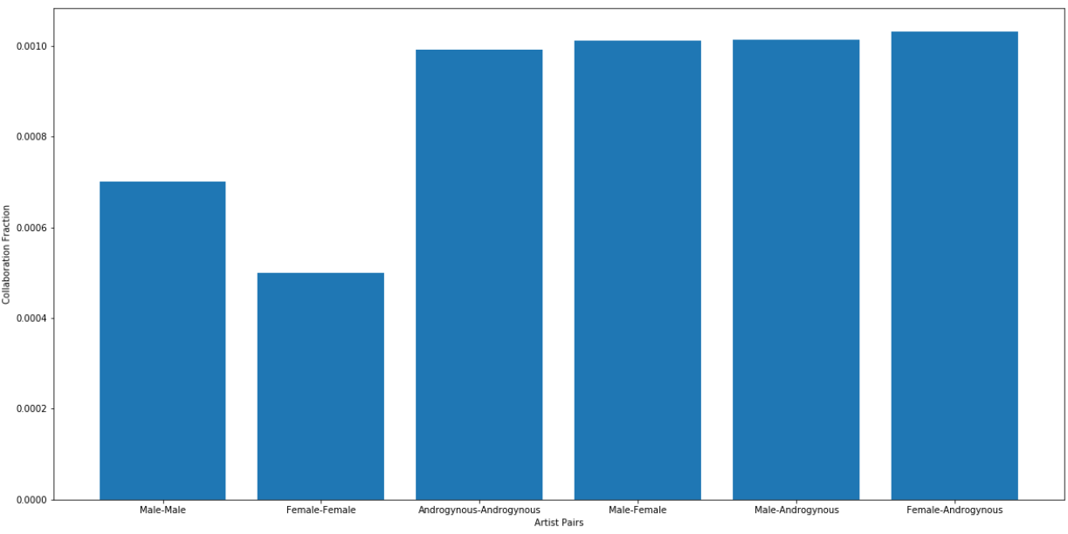
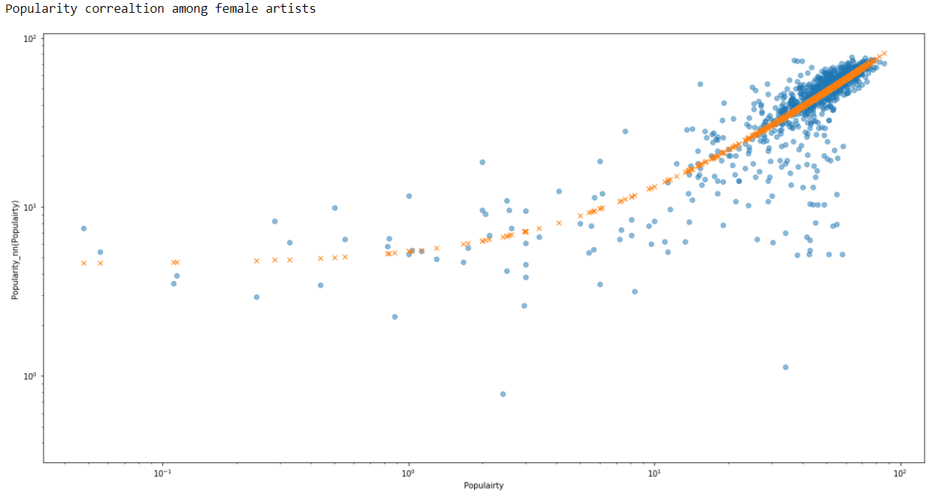
Hypothesis 3
Collaboration patterns change based on gender
High inter-gender collaboration

Slide 12
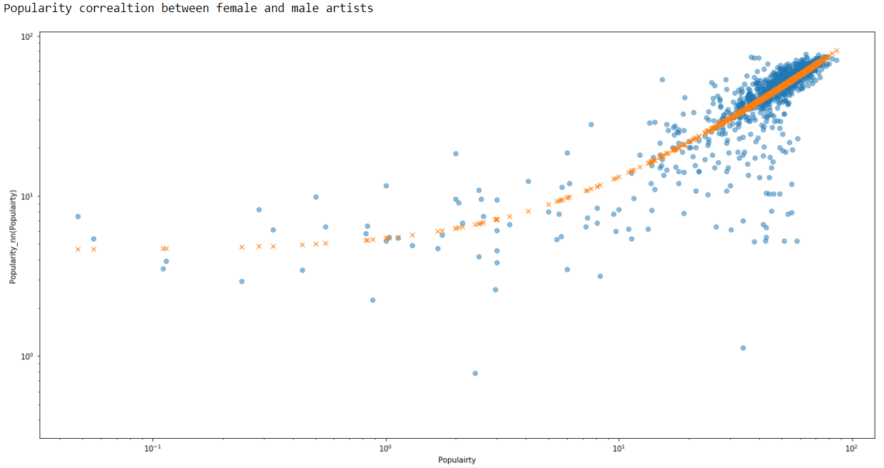
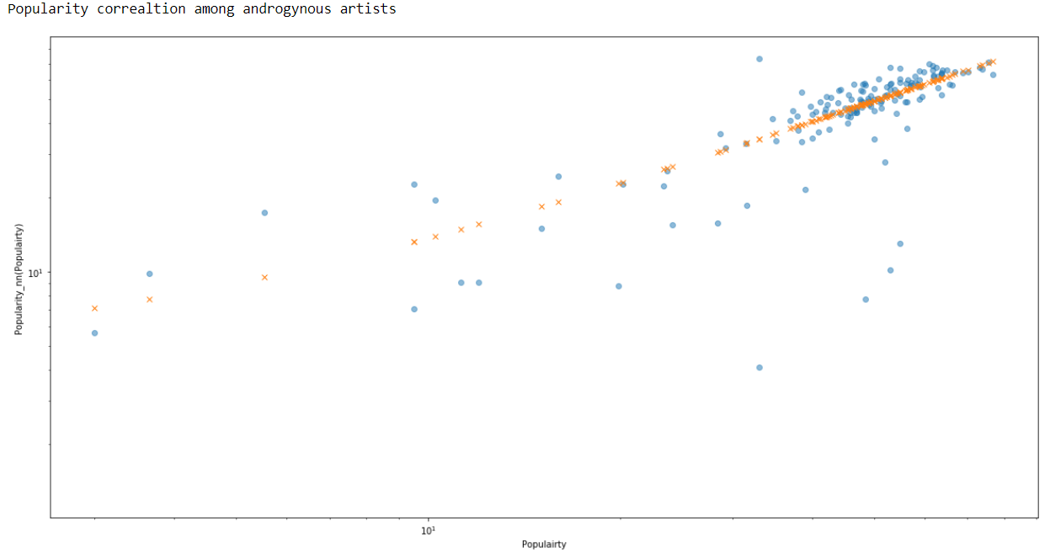
Hypothesis 3
Collaboration patterns change based on gender.
Comparatively less collaboration among male-male and female-female artists
Popularity correlation less strong among androgynous artists

Slide 13
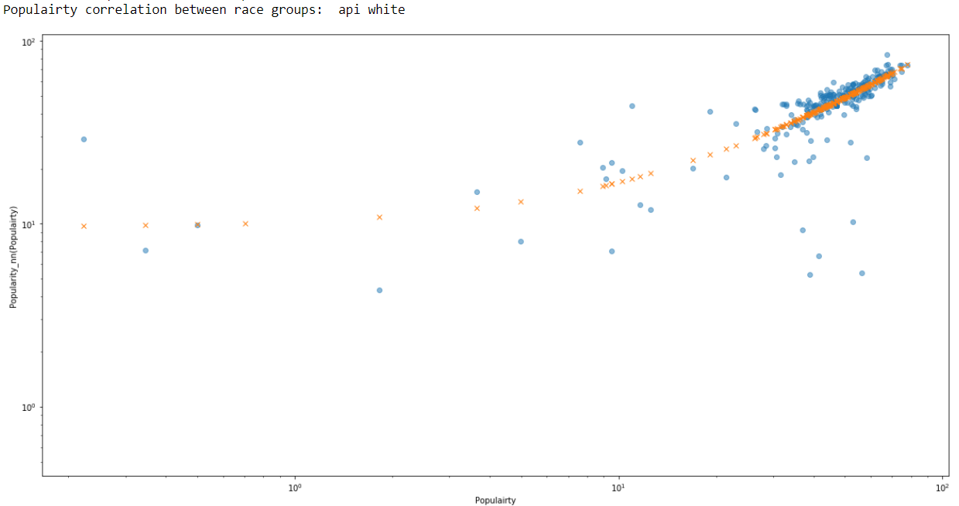
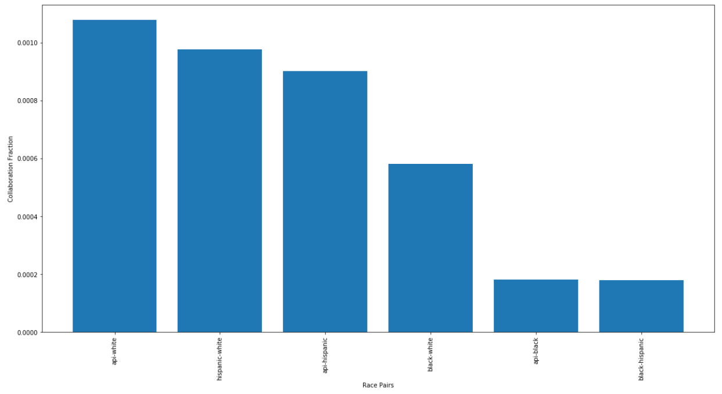
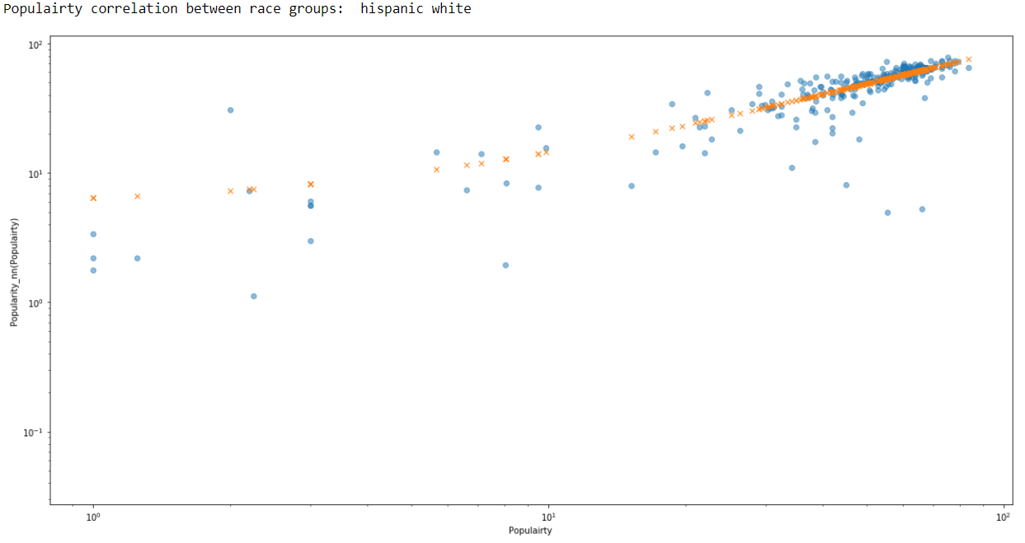
Hypothesis 4
Collaboration patterns change based on race.
Weaker popularity assortativity among races
Less collaboration of black artists with others

Slide 14
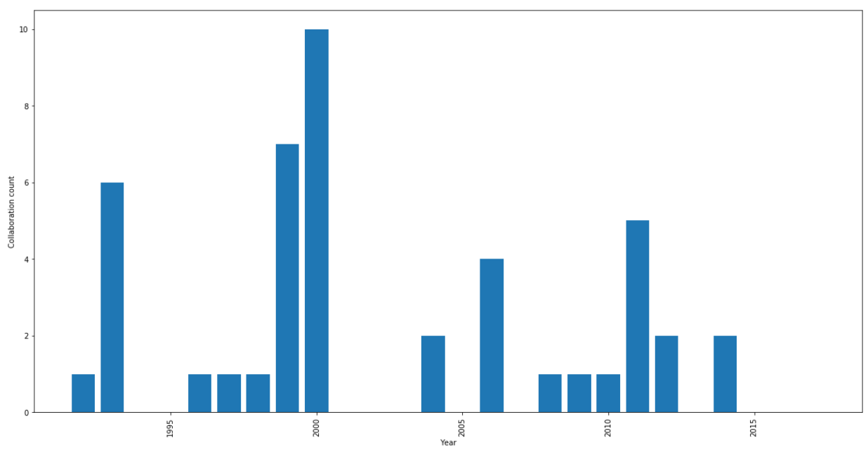
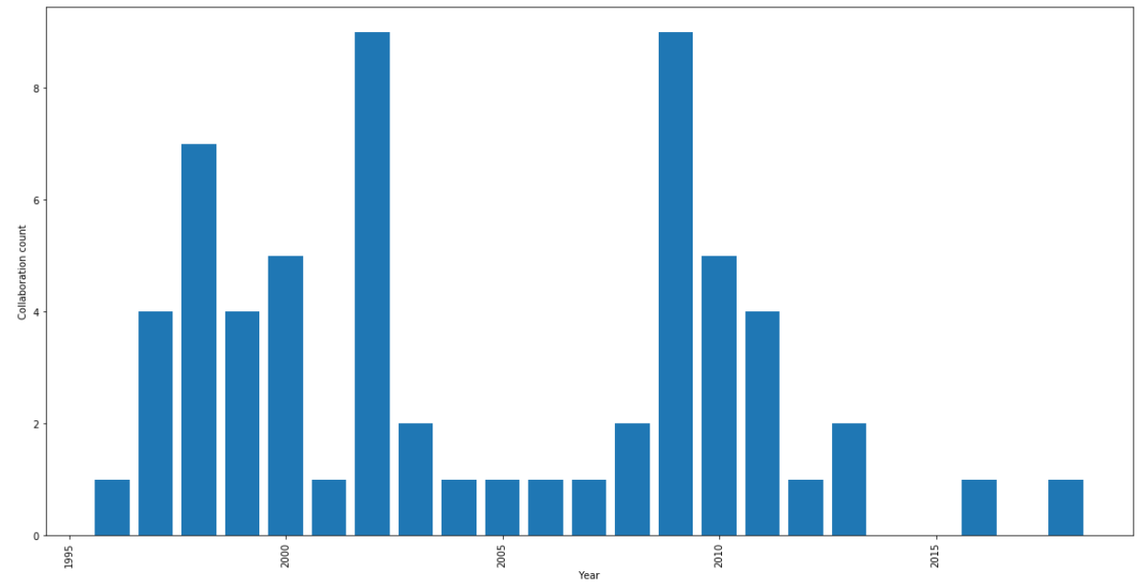
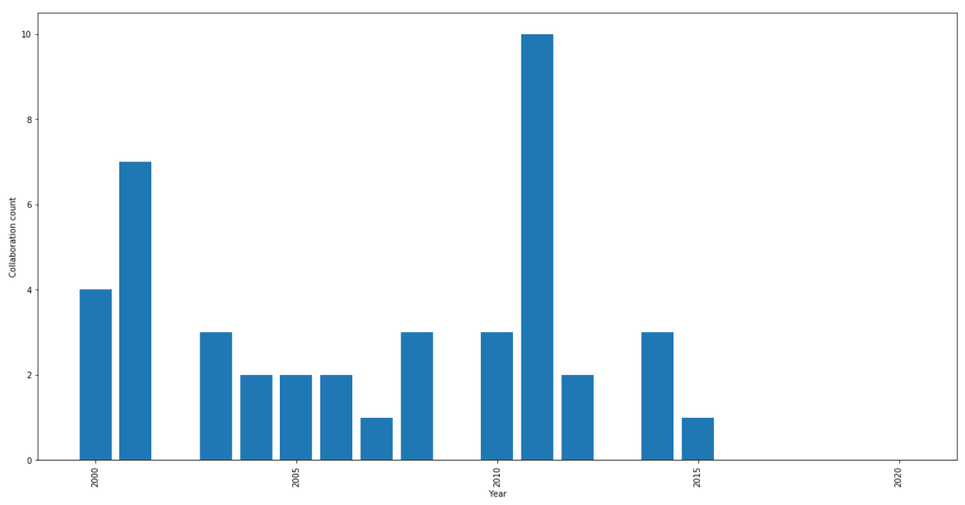
Hypothesis 5
Snoop Dogg
Collaboration patterns change over time
At an early phase of career any artist wants exposure, and during the later phase have nothing to prove and can do it for fun/novelty
Jay-Z
Ludacris

Slide 15
References
[1] Network Analysis of the Spotify Artist Collaboration Graph, Tobin South, Australian Mathematical Sciences Institute, 2017-2018.
URL: https://vrs.amsi.org.au/wp-content/uploads/sites/78/2018/04/tobin_south_vrs-report.pdf
[2] Musical trends and predictability of success in contemporary songs in and out of the top charts, Myra Interiano, Kamyar Kazemi, Lijia Wang,Jienian Yang, Zhaoxia Yu2and Natalia L. Komarova, R.Soc.opensci.5:171274.http://dx.doi.org/10.1098/rsos.171274.
[3] Community structure in social and biological networks, M. Girvan, M. E. J. Newman, Proceedings of the National Academy of Sciences Jun 2002, 99 (12) 7821-7826; DOI: 10.1073/pnas.122653799.
[4] Networking data. A network analysis of Spotify's socio- technical related artist network, Silvia Donker, International Journal of Music Business Research, April 2019, vol. 8 no. 1.
[5] Newman, M.E.J. Networks: An Introduction. Oxford University Press. 2010.
Notes:
GitHub: https://github.com/ChatterjeeAyan/Spotify_collaboration_network

